Slide 1
Local Infastructure deploy
Local VM with Terraform
Vagrant
Infrastructure deploy
User data Jenkins
SSH key SecGroup
CI/CD
Jenkins build deploy
GitHub
Infrastructure deploy
EC2
Terraform
Push
GitHub Webhook
EC2 instance
Terraform
Infrastructure destroy
Terraform destroy
Step 1
Step 2
Step 3
Step 4
Step 5

Slide 2
TASK PROGRESS
I used Vagarnt for creation VM Ubuntu whith Terraform (step1). Then I create instance Ubuntu on AWS whith Jenkins (step2).
After that I configurate Jenkins (step3).
Developer with Windows OS and installed Bush plus credential for GitHub. He edits python scrypt and push on GitHub.

Slide 3

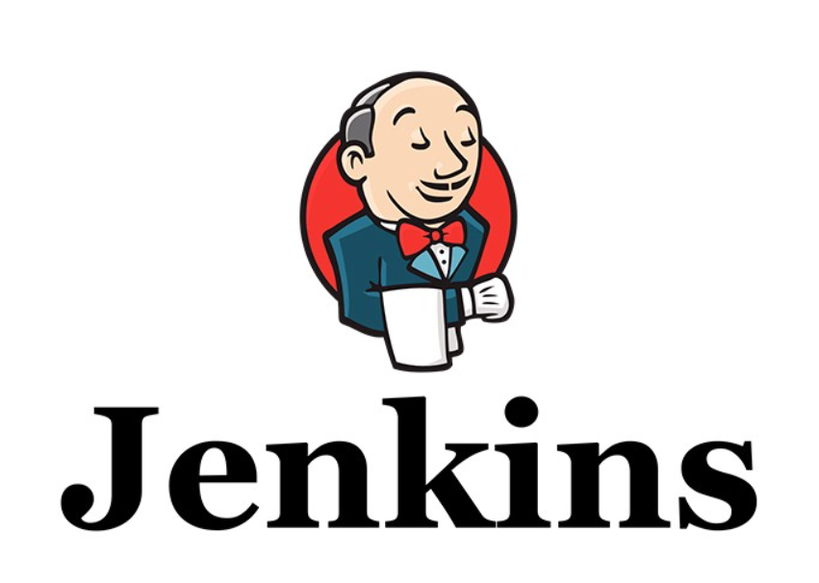
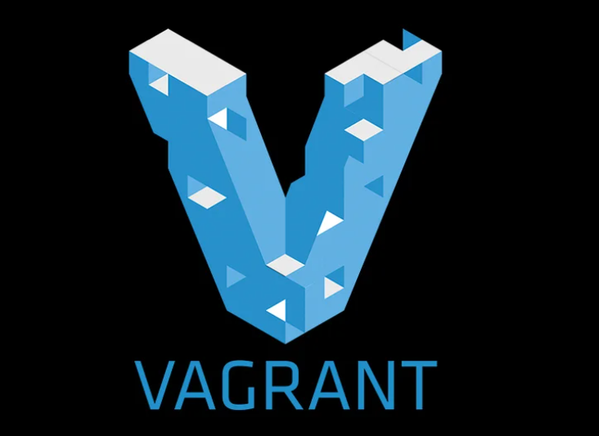
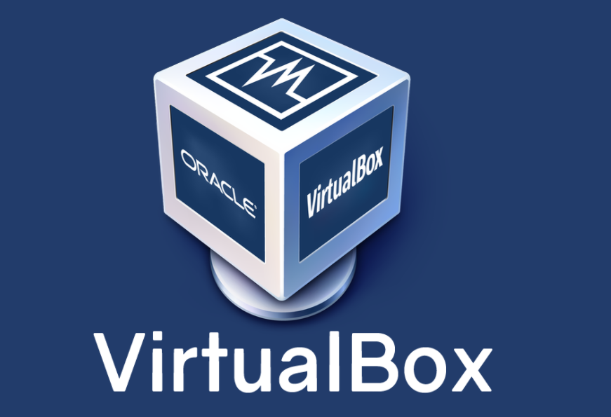
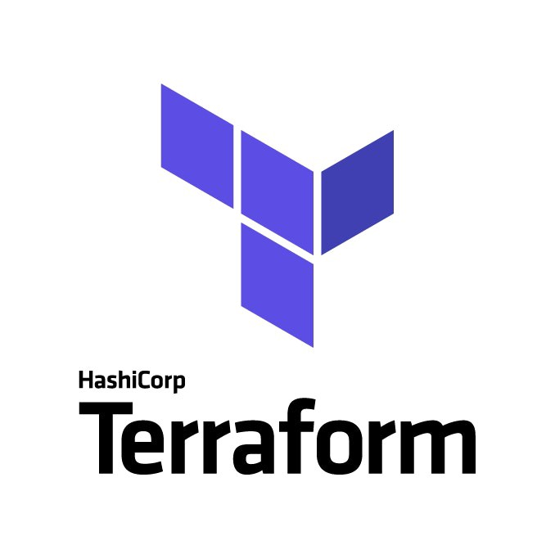

DEPLOY TELEGRAMM BOT
For my project I used: Github, Vagrant, Virtualbox, Terraform, Jenkins, AWS
Jenkins login to GitHub
Jenkins gitclon on AWS EC2
Create VM
Develop in VM
Push on GitHub
Vagrant create VM
VM with Terraform
Terraform instance on AWS

Slide 4
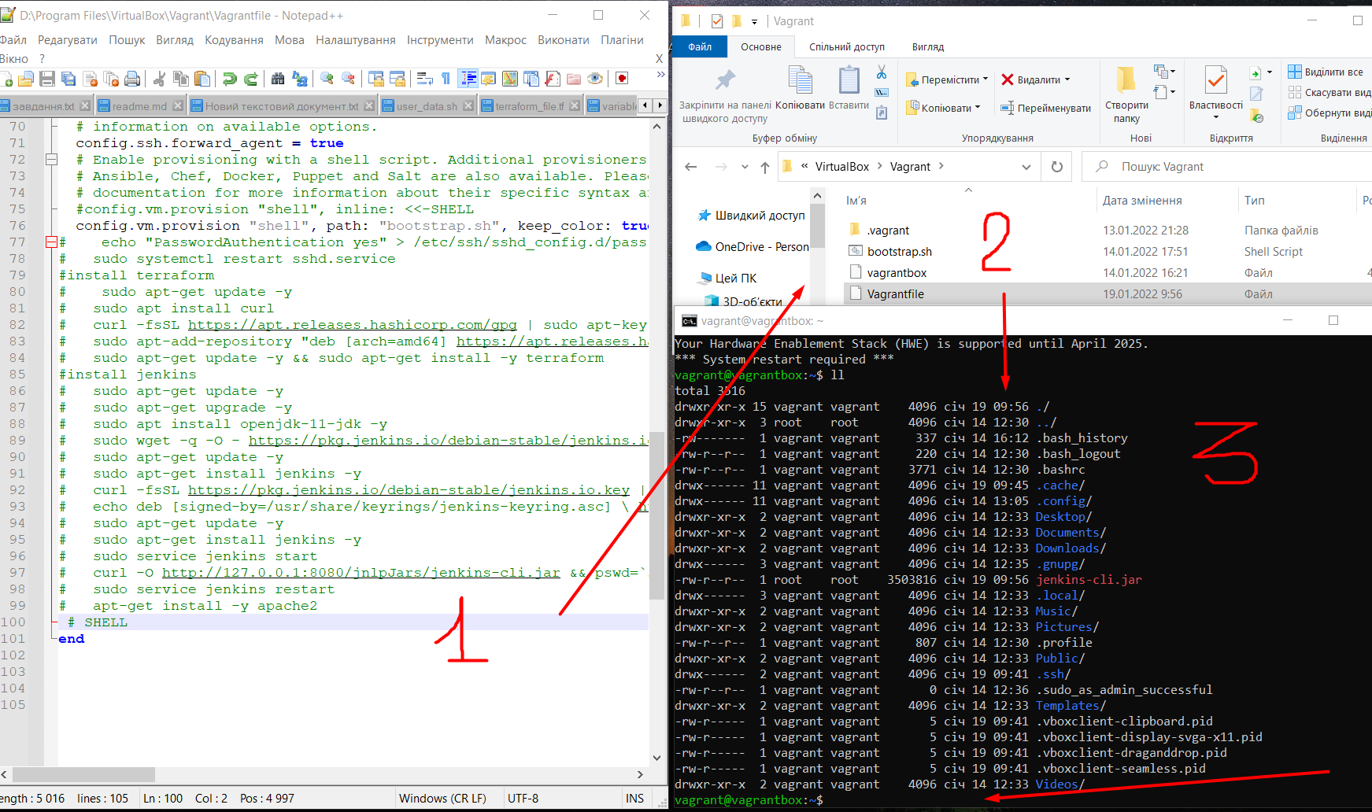
Created vm with vagrant then vagrant up. After then installed terraform.

Slide 5
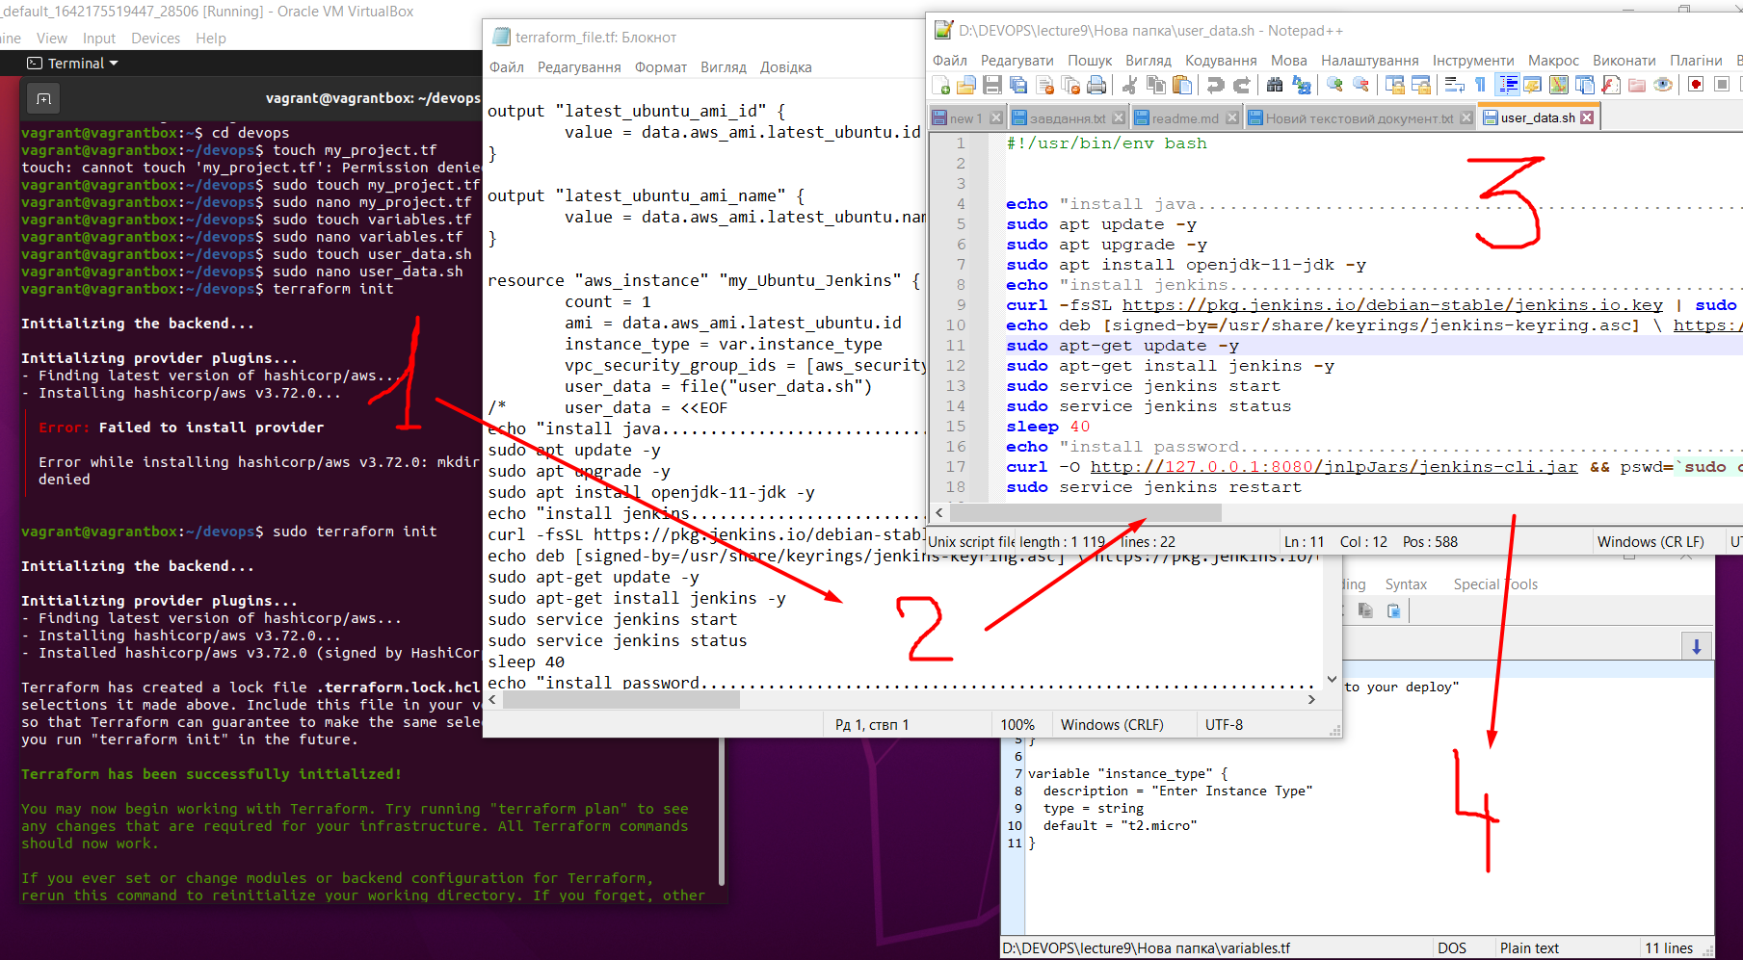
Created (vagrant ssh) project folder and terraform files

Slide 6
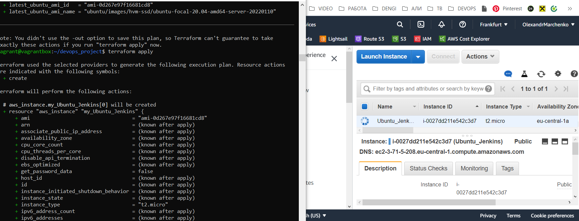
used terraform for create instance on aws. Instance include jenkins

Slide 7
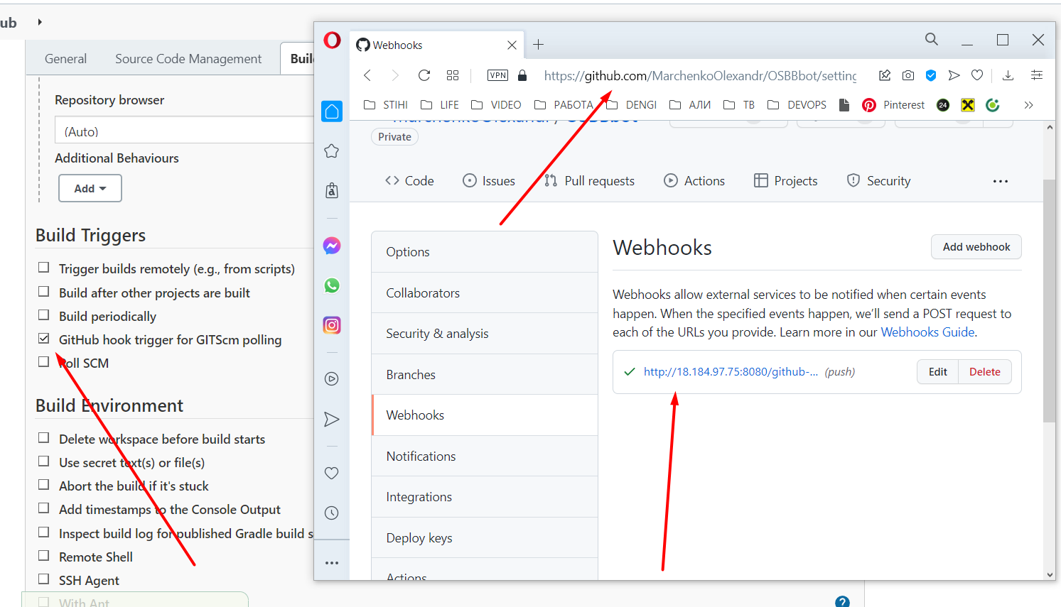
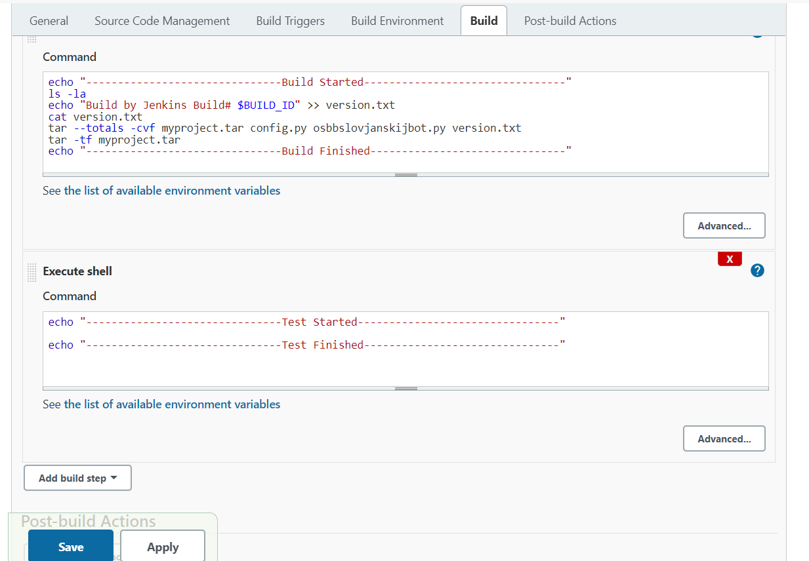
Jenkins pull from github project and deploy to server

Slide 8
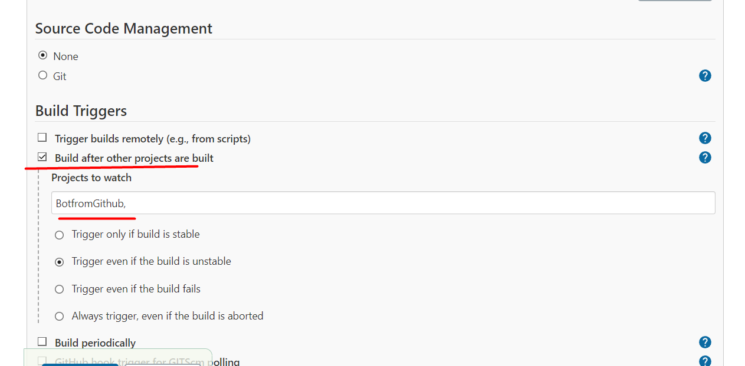
Simple pipeline

Slide 9
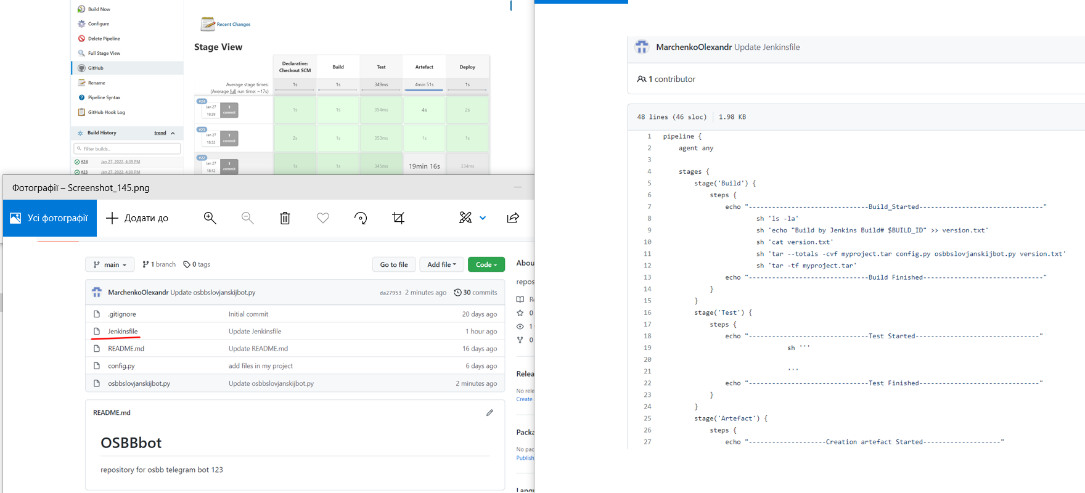
ADD PIPELINE AND JENKINS FILE ON GITHUB

Slide 10
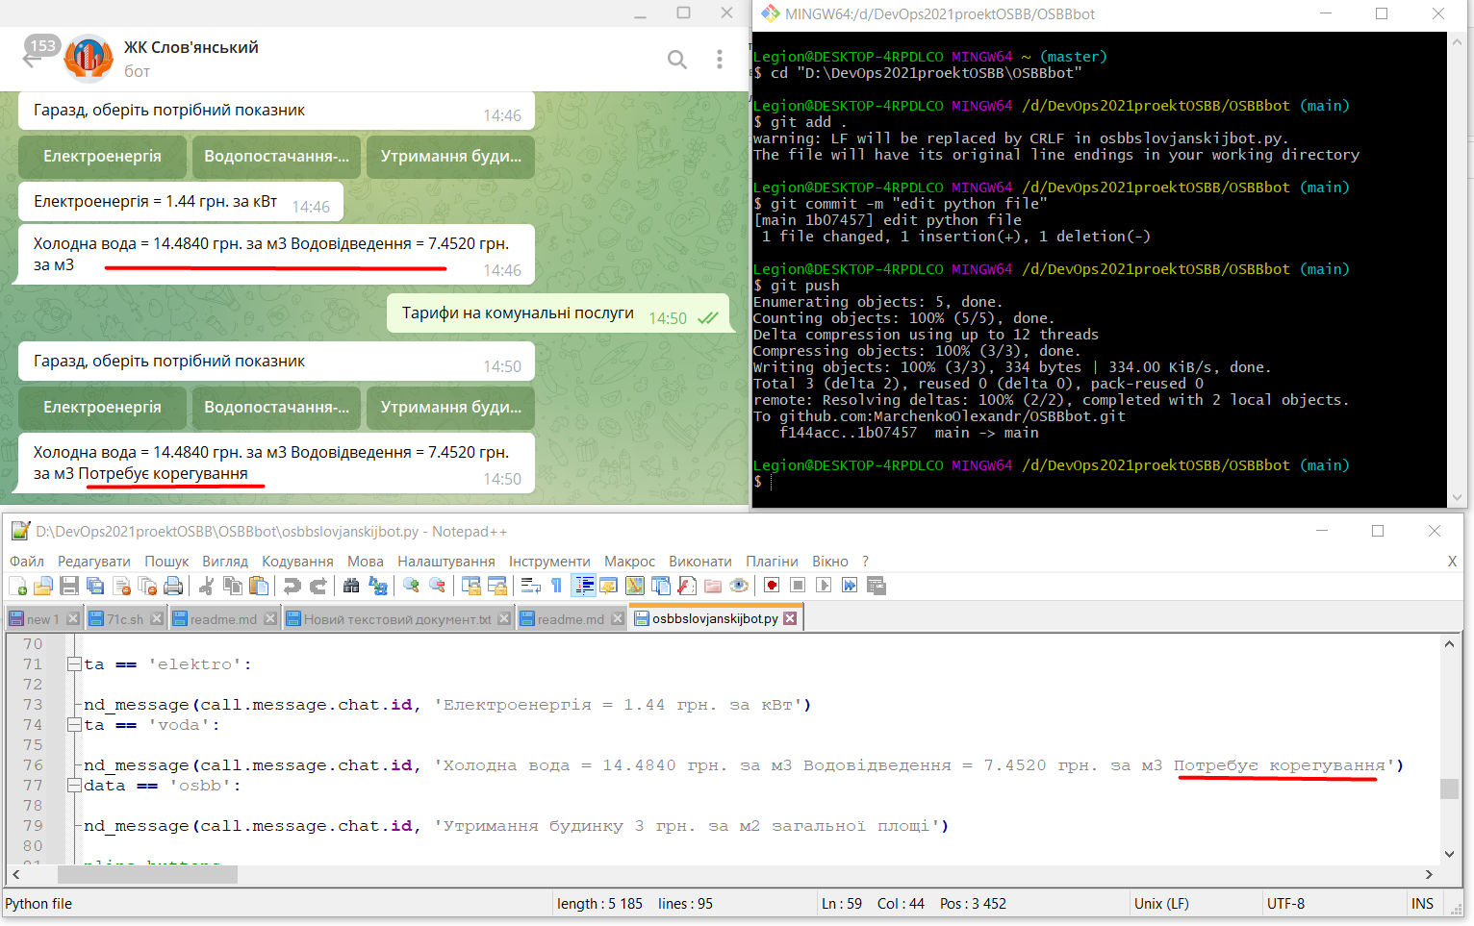
Developer changes python scrypt. Result

